Slide 1
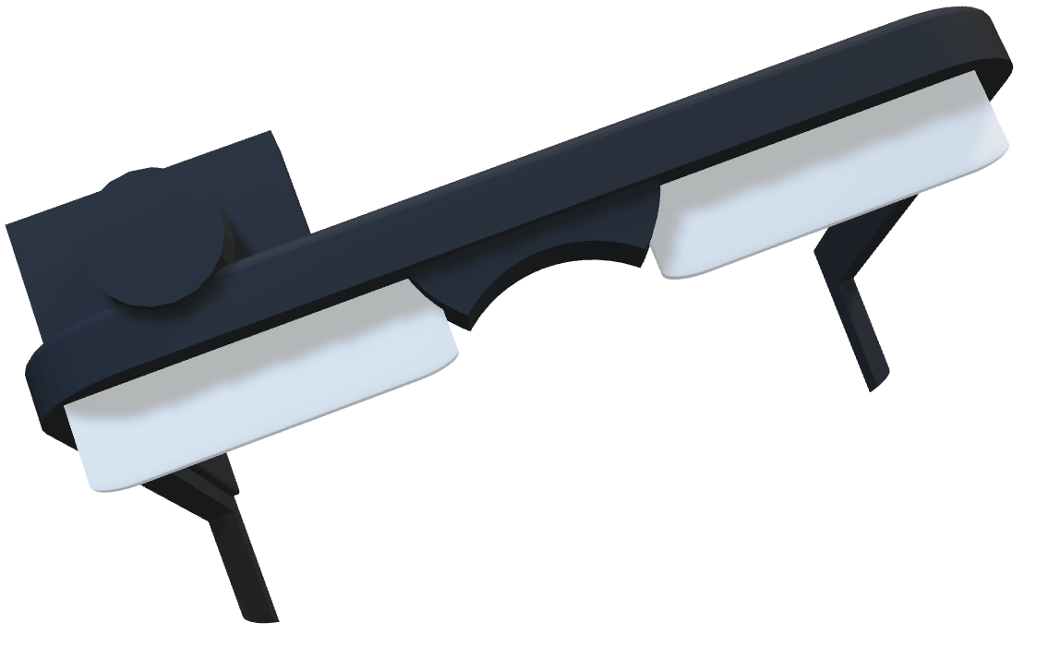
NaviGaze
Urvi Jain, Cesar Briones, Aditya Mathur, Zeki Sert
Envisioning The Future

Slide 2
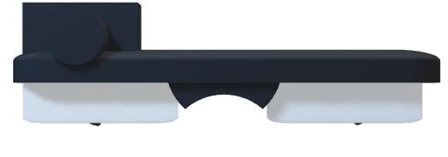




Our Mission
At NaviGaze our mission is to empower and enhance the lives of visually impaired individuals by providing innovative, accessible, and reliable smart glasses. We are dedicated to harnessing the power of crowd learning and AI technology to create an inclusive world that breaks down barriers and fosters independence, confidence, and connectivity for our users.

Slide 3
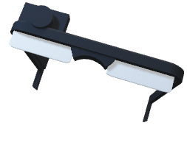
Challenges Compared
Traditional VAD
NaviGaze
White Canes:
Limited Range and Information
Guide Dogs:
Expensive and difficult maintenance
GPS Navigation Apps:
Limited to outdoor spaces
Other devices:
Limited Customization
Low cost of entry
High information and range provided
Easy to maintain
Outdoor and Indoor spaces
Customizable by user

Slide 4

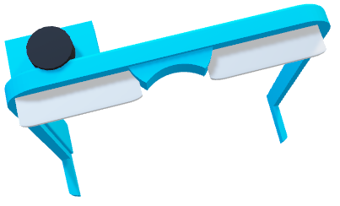
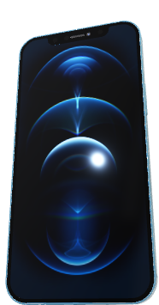
How It Works

Slide 5
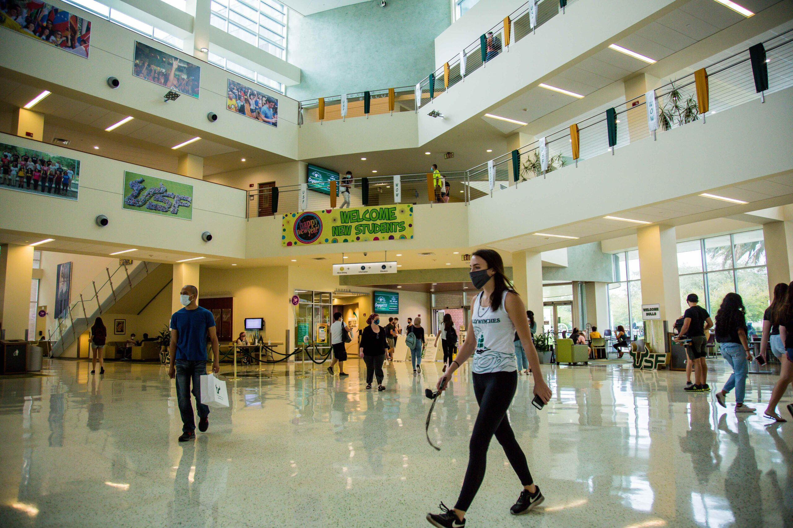
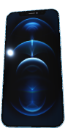


How It Works
NaviGlass Photo
NaviGaze App
Google Cloud Image Detection
Google Cloud Text to Speech
NaviGaze App
NaviGlass Speakers
NaviGaze App
User Images
Google Cloud Image Detection
Google Maps Locational Integration
NaviGaze App
NaviGlass Speakers

Slide 6
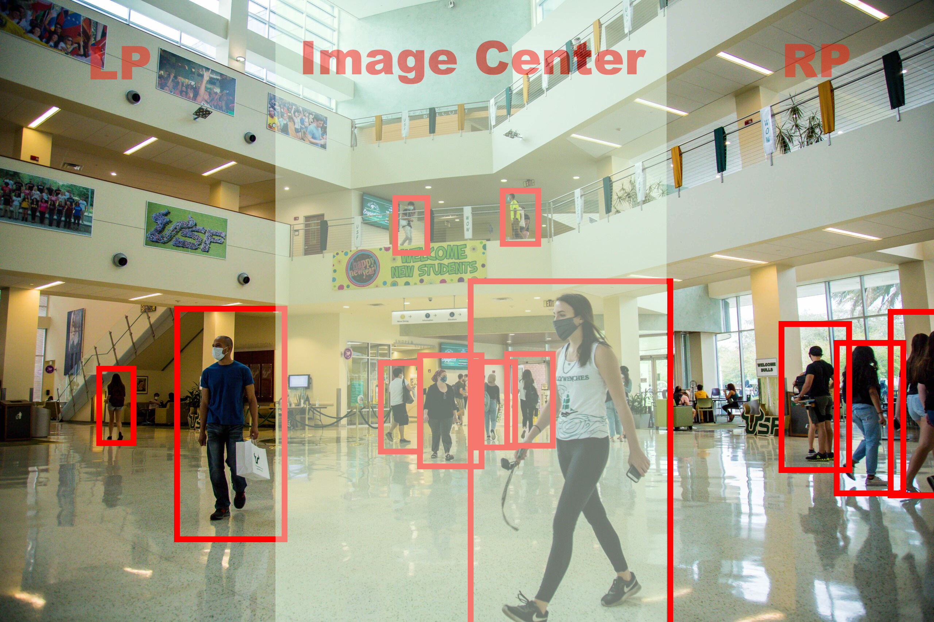
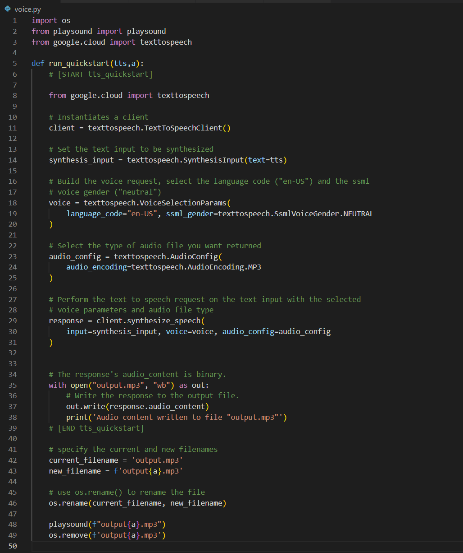


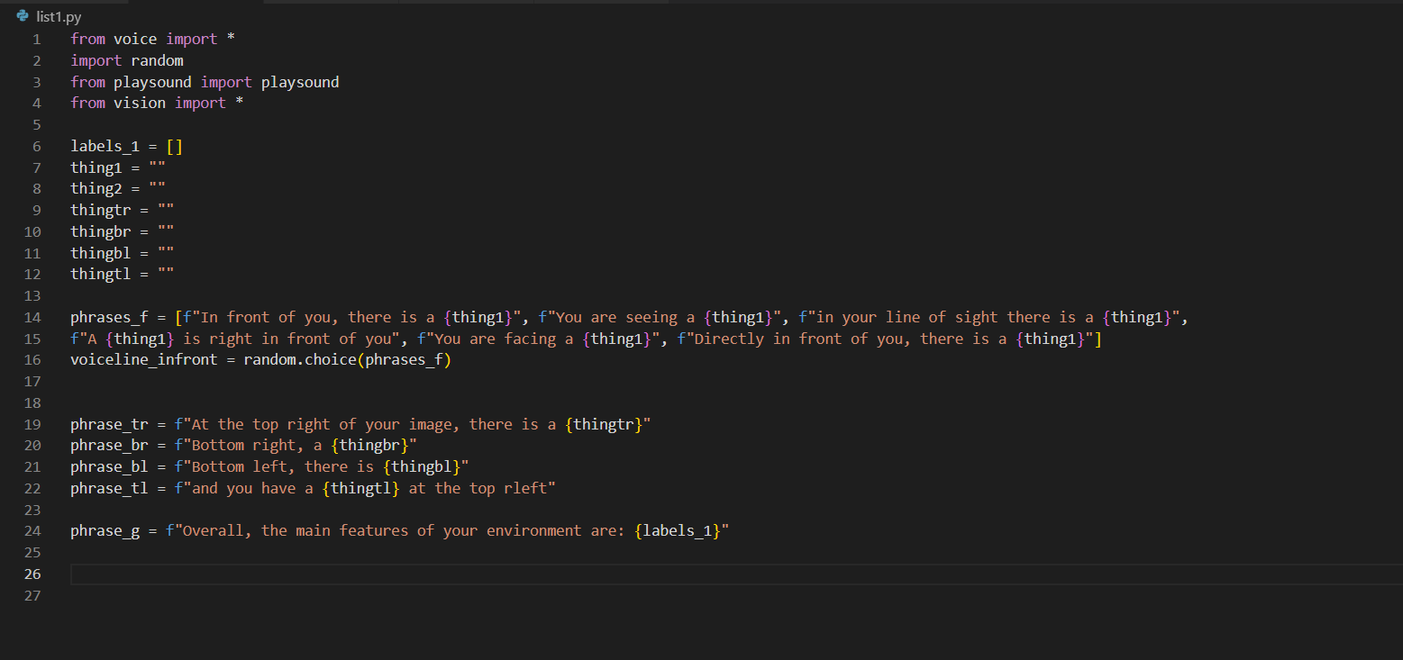


Behind The Scenes

Slide 7

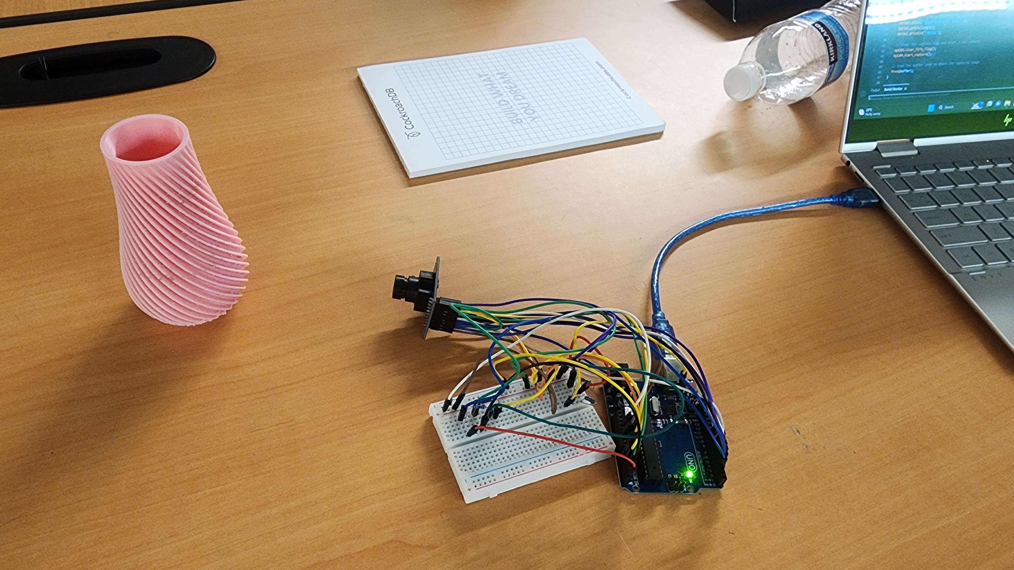
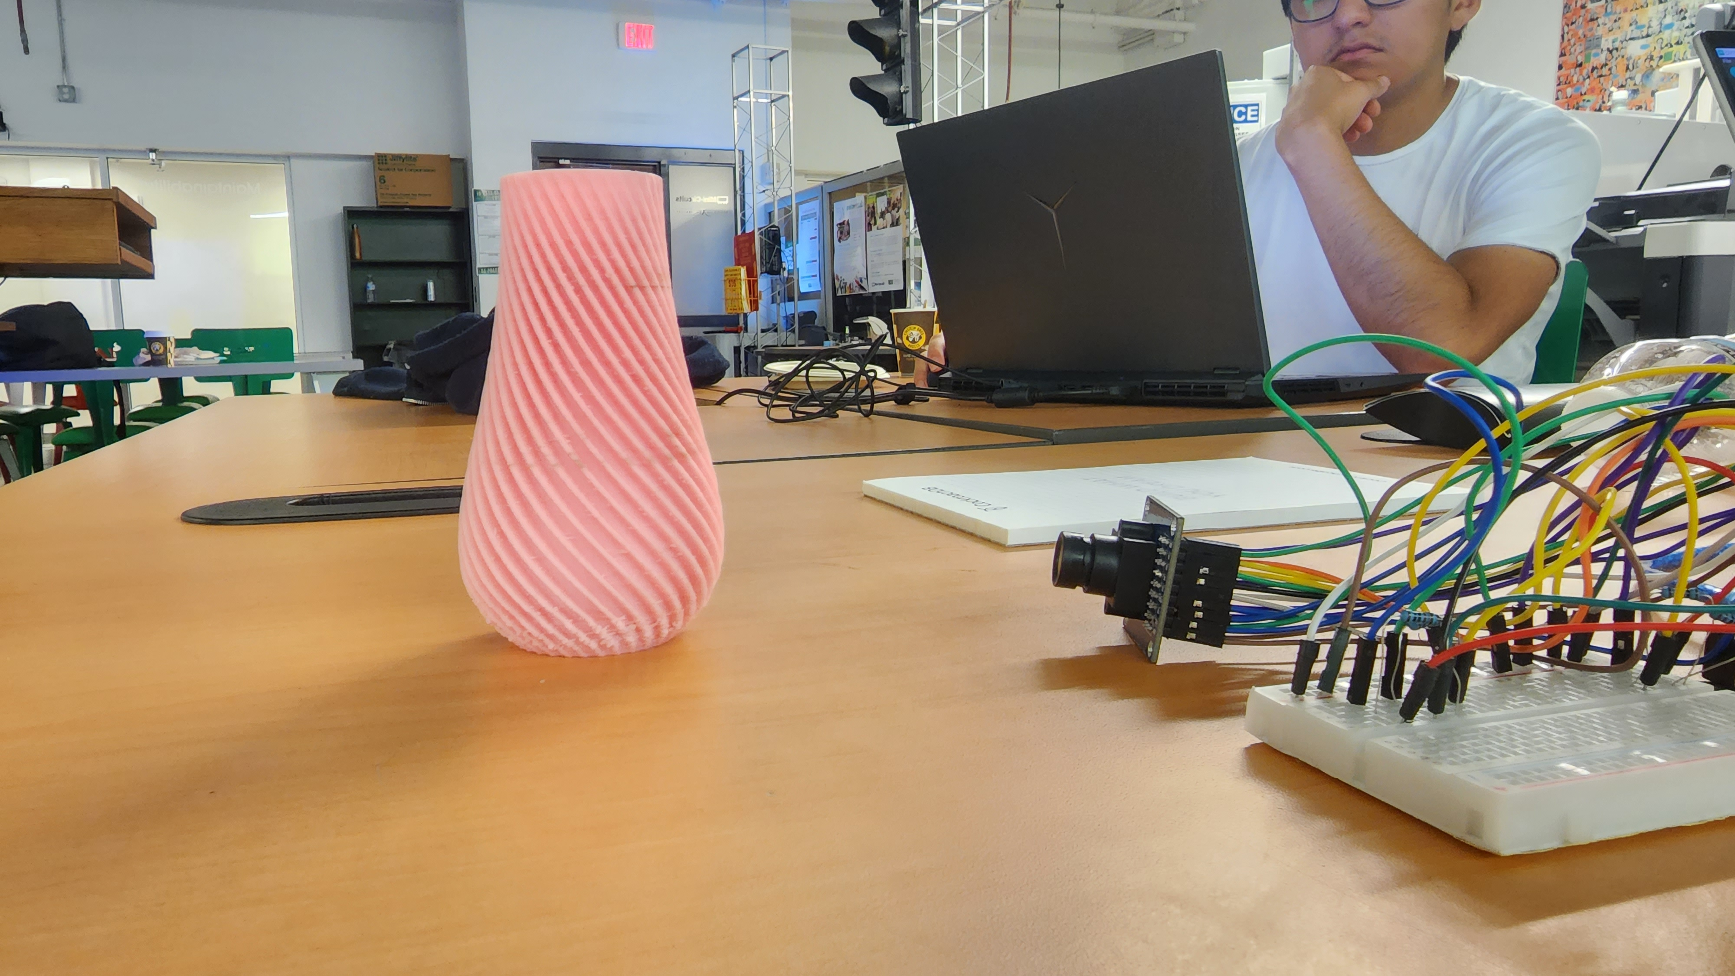
Behind The Scenes

Slide 8
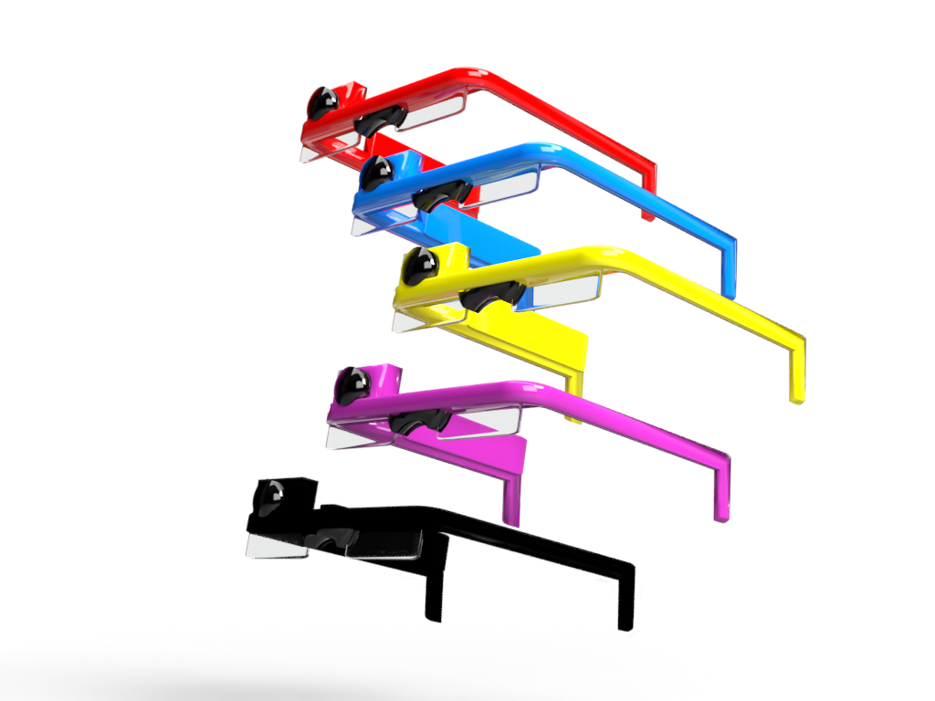
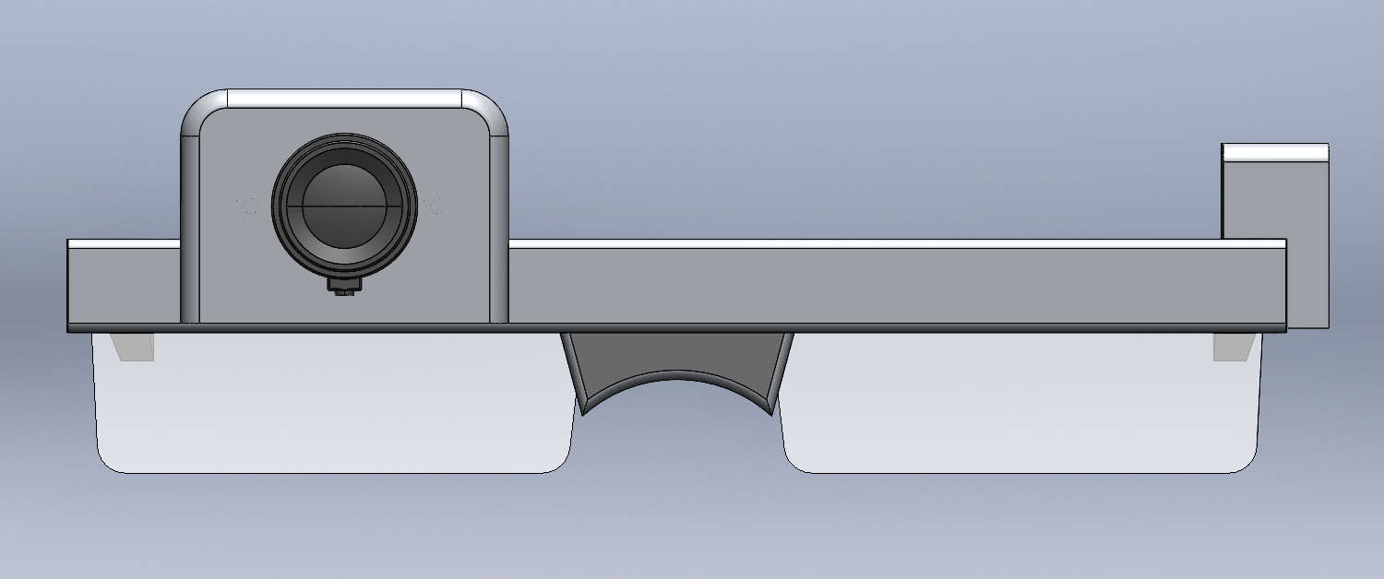
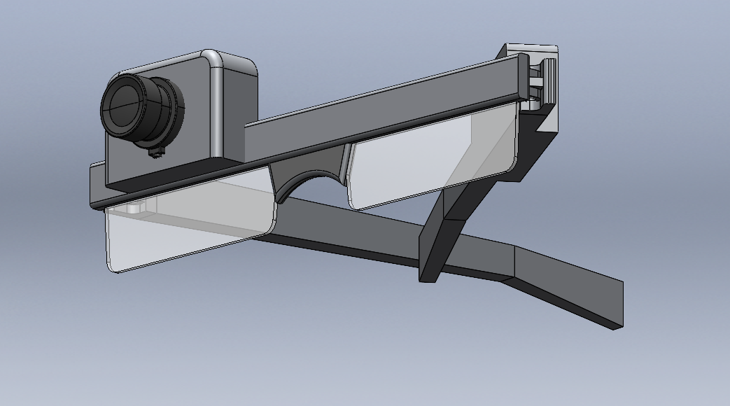
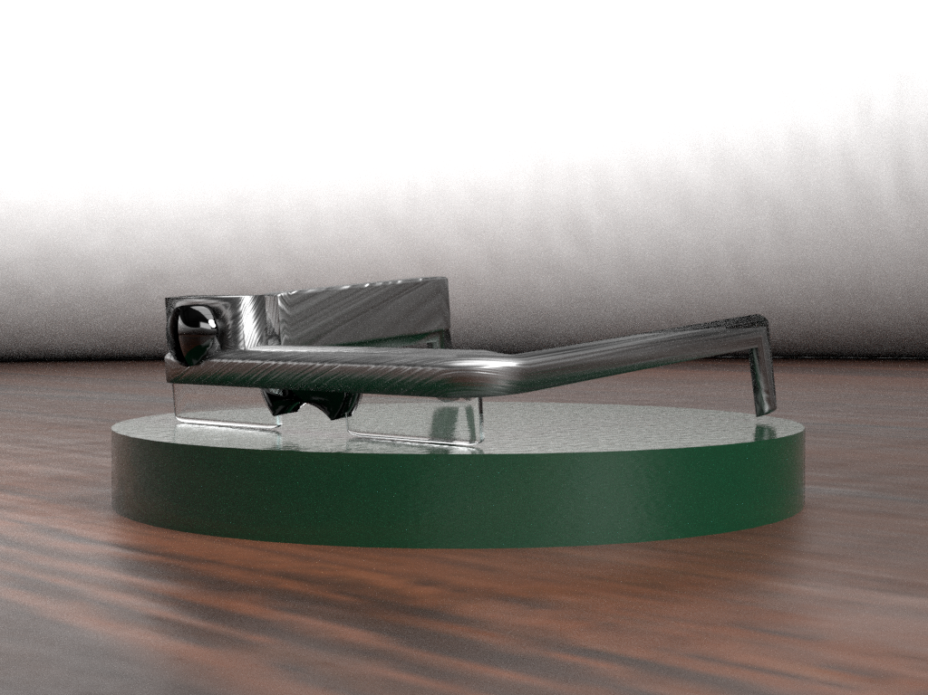

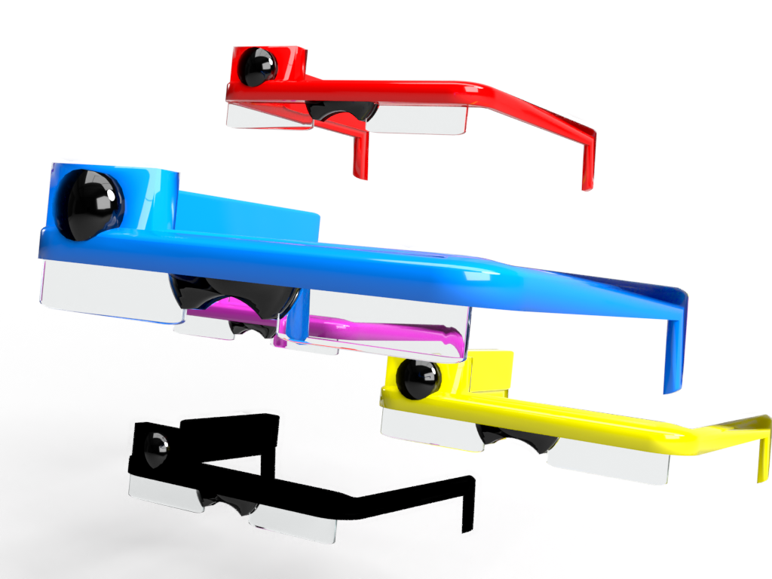

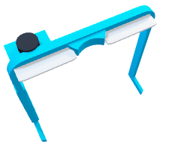
Behind The Scenes

Slide 9
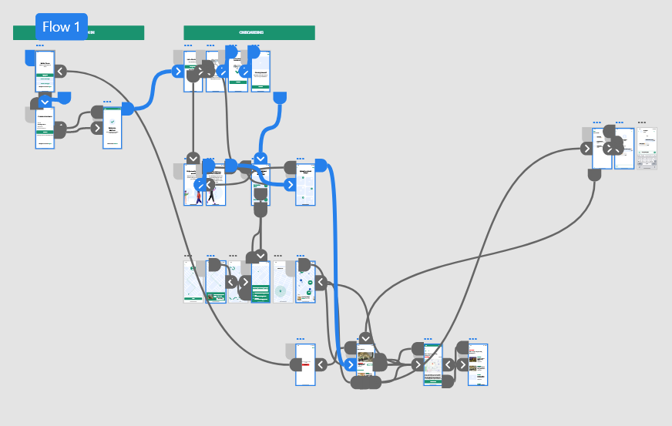
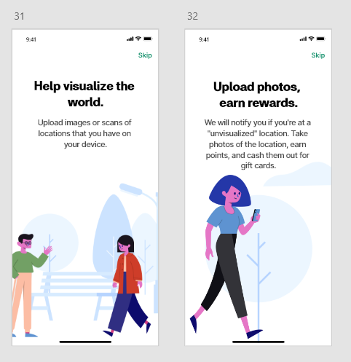


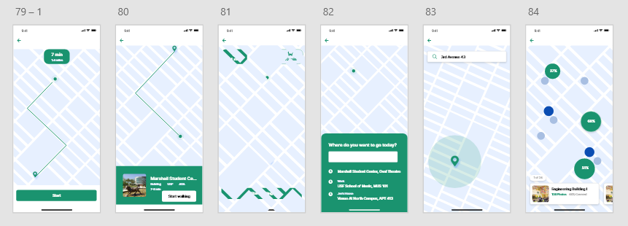
Behind The Scenes

Slide 10
Business Model
How we make profit:
Product sales
Monthly Subscriptions to Navi+
Accessories and customization
Selling locational Data
NOT how we make profit:
Selling user data
Mandatory app subscription
Hidden usage fees

Slide 11
Technical Challenges
Technical Challenges:
Integrating Google Cloud to depict image contents
Creating an ergonomic and cost effective product design
Designing a beautiful and accessible front end
Dividing image into sections to analyze
Arduino camera integration
Creative Solutions:
Integrating Arduino camera module as a cost effective camera
Implementing Google Cloud text to speech API for a natural sounding voice
Using artificial intelligence to depict image contents
Gamification of the app to incentivize users to contribute

Slide 12
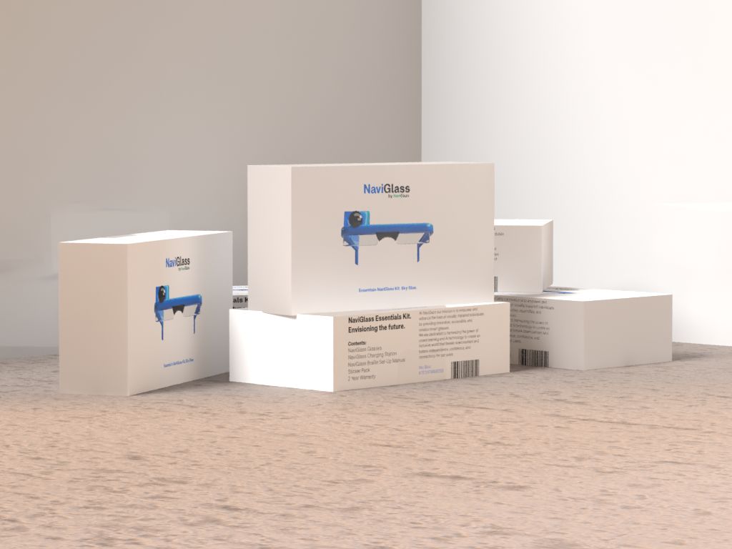
Thank You

